Slide 1
Laser Range Finder
How it works ?

Slide 2
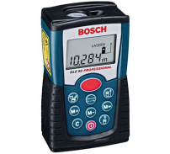
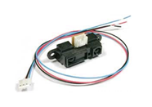
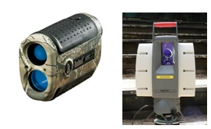
Types of Laser Range finders
Time of Flight
(TOF)
Phase shift
Triangulation
Interference
Long range
Middle range
Short range
Very short range
Good accuracy
Good to poor accuracy
Very accurate
Middle accuracy
Very fast
Slow
???
Not so fast
???
Affordable
Expensive
Cheap
Application: medical & scientific fields.
Application: Aiming tools, landscape & constructions scanning tools, LIDARs, etc.
Application: Constructions, DIY
Application: Copiers, robotics, industrial machines

Slide 3

Types of Laser Range finders
Phase shift
Technical data
Laser diode 635 nm, < 1 mW
Measurement range 0,05 - 50 m
Laser class 2
Measurement accuracy ± 1.5 mm
Measurement time, typical < 0.5 s
Measurement time, max. 4 s
Power supply 4 x 1.5 V LR03
Weight, approx. 0,175 kg
Length 100 mm
Height 32 mm
Units of measurement m

Slide 4
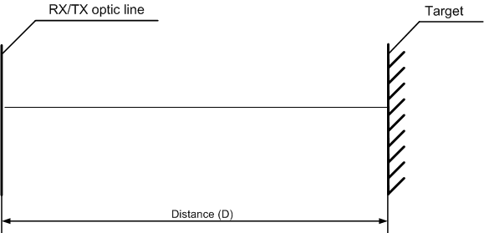
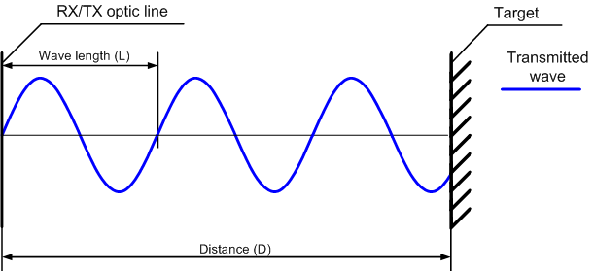
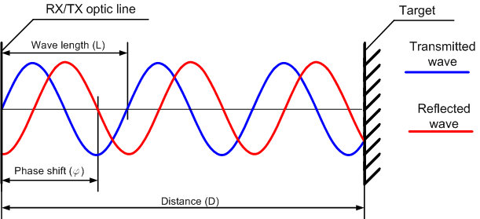
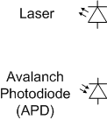
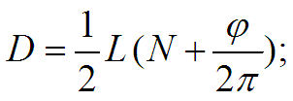

Phase Shift Laser Range finder
Basic principles

Slide 5
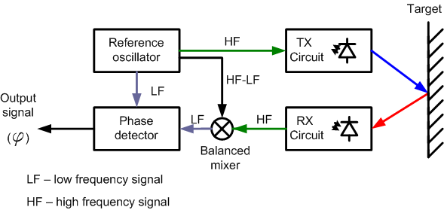
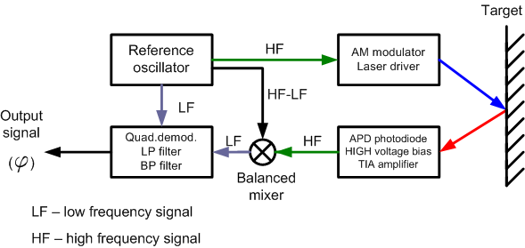
Phase Shift Laser Range finder
Simplified blocks scheme

